Slide 1
CHAPTER 6
Basic SQL

Slide 2
Chapter 6 Outline
SQL Data Definition and Data Types
Specifying Constraints in SQL
Basic Retrieval Queries in SQL
INSERT, DELETE, and UPDATE Statements in SQL
Additional Features of SQL

Slide 3
Basic SQL
SQL language
Considered one of the major reasons for the commercial success of relational databases
SQL
SQL Actually comes from the word “SEQUEL” which was the original term used in the paper: “SEQUEL TO SQUARE” by Chamberlin and Boyce. IBM could not copyright that term, so they abbreviated to SQL and copyrighted the term SQL.
Now popularly known as “Structured Query language”.
SQL is an informal or practical rendering of the relational data model
Slide 6- 4

Slide 4
SQL Data Definition, Data Types, Standards
Terminology:
Table, row, and column used for relational model terms relation, tuple, and attribute
CREATE statement
Main SQL command for data definition
The language has features for : Data definition, Data Manipulation, Transaction control, Indexing , Security specification, Active databases , Multi-media , Distributed databases etc.

Slide 5
Schema and Catalog Concepts in SQL
We cover the basic standard SQL syntax – there are variations in existing RDBMS systems
SQL schema
Identified by a schema name
Includes an authorization identifier and descriptors
for each element
Schema elements include
Tables, constraints, views, domains, and other constructs
Each statement in SQL ends with a semicolon

Slide 6
Schema and Catalog Concepts in SQL (cont’d.)
CREATE SCHEMA statement
CREATE SCHEMA COMPANY AUTHORIZATION
‘Jsmith’;
Catalog
Named collection of schemas in an SQL environment
An SQL environment is basically an installation of an SQL-compliant RDBMS on a computer system.
A catalog always contains a special schema called INFORMATION_SCHEMA,which provide information on all the schemas in the catalog and all the element descriptors in these schemas. .

Slide 7
The CREATE TABLE Command in SQL
Specifying a new relation
Provide name of table
Specify attributes, their types and initial constraints
The attributes are specified first, and each attribute is given a name, a data type to specify its domain of values, and any attribute constraints, such as NOT NULL.
The key, entity integrity, and referential integrity constraints can be specified within the CREATE TABLE statement after the attributes are declared, or they can be added later using the ALTER TABLE command

Slide 8
The CREATE TABLE Command in SQL (cont’d.)
Can optionally specify schema:
CREATE TABLE COMPANY.EMPLOYEE ...
or
CREATE TABLE EMPLOYEE ...
Base tables (base relations)
Relation and its tuples are actually created and stored as a file by the DBMS
Virtual relations (views)
Created through the CREATE VIEW statement. Do not correspond to any physical file.

Slide 9
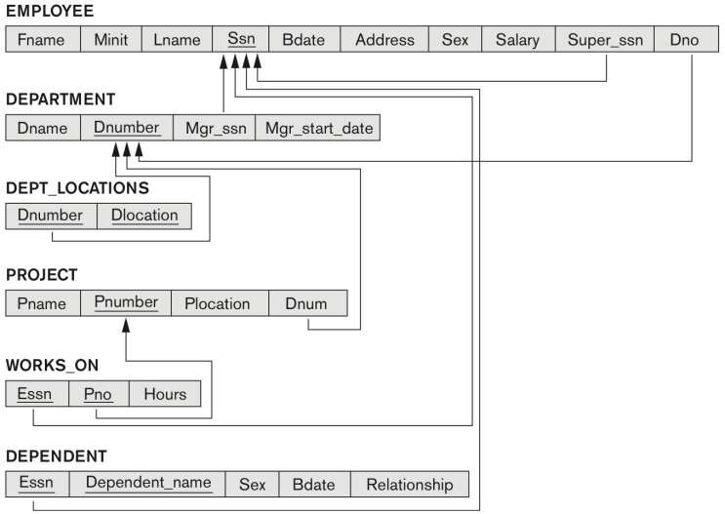
COMPANY relational database schema

Slide 10
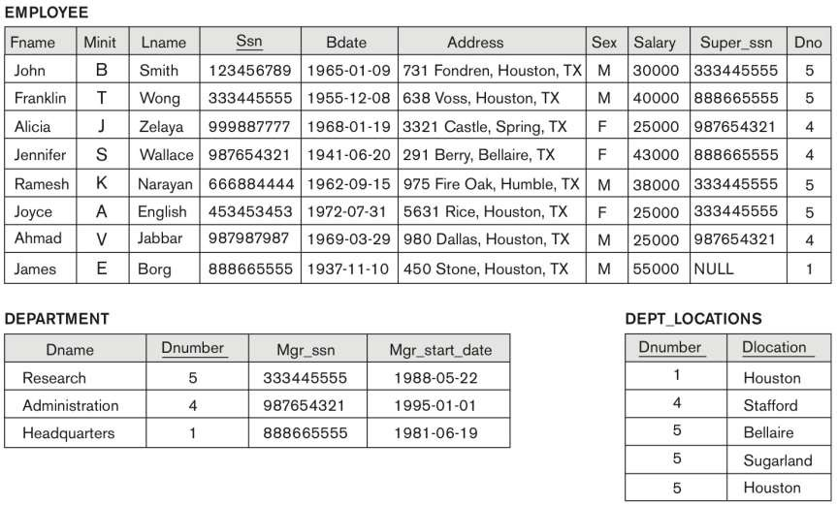
One possible database state for the COMPANY relational database schema

Slide 11
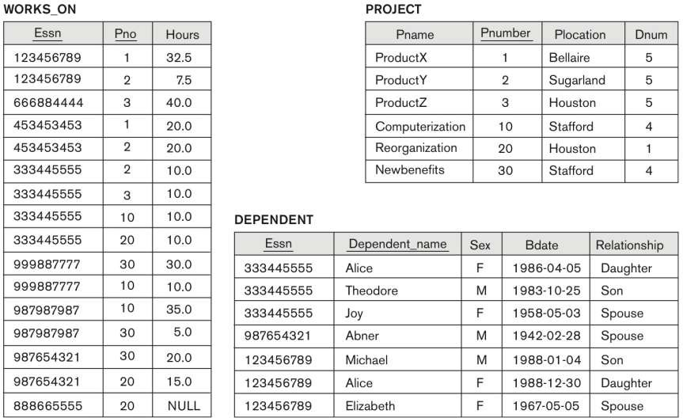
One possible database state for the COMPANY relational database schema – continued

Slide 12
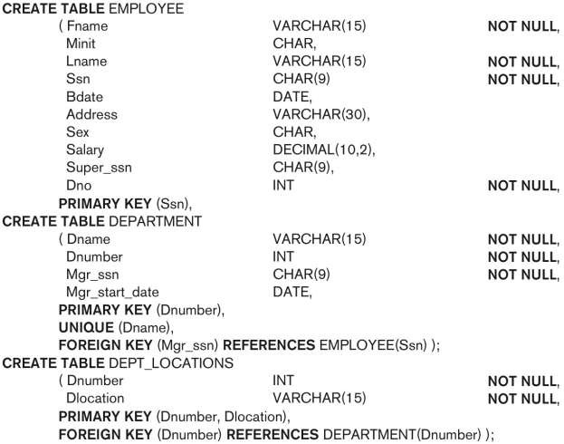
SQL CREATE TABLE data definition statements for defining the COMPANY schema

Slide 13
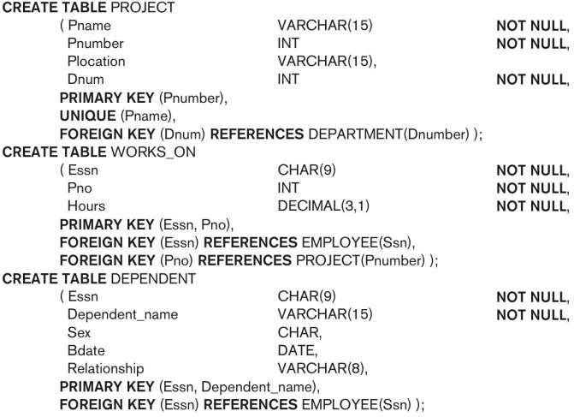
SQL CREATE TABLE data definition statements for defining the COMPANY schema

Slide 14
Attribute Data Types and Domains in SQL
Basic data types
Numeric data types
Integer numbers: INTEGER, INT, and SMALLINT
Floating-point (real) numbers: FLOAT or REAL, and
DOUBLE PRECISION
Formatted numbers can be declared by using DECIMAL(i,j)—or DEC(i,j) or NUMERIC(i,j)—where i, the precision, is the total number of decimal digits and j, the scale, is the number of digits after the decimal point.
The default for scale is zero, and the default
for precision is implementation-defined.

Slide 15
Attribute Data Types and Domains in SQL
Basic data types
Character-string data types
Fixed length: CHAR(n), CHARACTER(n)
Varying length: VARCHAR(n), CHAR VARYING(n), CHARACTER VARYING(n)
where n is the number of characters
When specifying a literal string value, it is placed between single quotation marks (apostrophes), and it is case sensitive
There is also a concatenation operator denoted by || (double vertical bar) that can concatenate two strings in SQL. For example,‘abc’|| ‘XYZ’ results in a single string ‘abcXYZ’

Slide 16
Attribute Data Types and Domains in SQL
Basic data types
Character-string data types
Another variable-length string data type called CHARACTER LARGE OBJECT or CLOB is also available to specify columns that have large text values, such as documents.
The CLOB maximum length can be specified in kilobytes (K), megabytes (M), or gigabytes (G).
For example, CLOB(20M) specifies a maximum length of 20 megabytes.

Slide 17
Attribute Data Types and Domains in SQL (cont’d.)
Bit-string data types
Fixed length: BIT(n)
Varying length: BIT VARYING(n)
Boolean data type
Values of TRUE or FALSE or NULL or UNKNOWN
DATE data type
Ten positions
Components are YEAR, MONTH, and DAY in the form YYYY-MM-DD
Multiple mapping functions available in RDBMSs to change date formats

Slide 18
Attribute Data Types and Domains in SQL (cont’d.)
The TIME data type
At least eight positions, with the components HOUR, MINUTE, and SECOND in the form HH:MM:SS
Only valid dates and times should be allowed by the
SQL implementation
A TIME WITH TIME ZONE data type includes an additional six positions for specifying the displacement from the standard universal time zone, which is in the range +13:00 to –12:59 in units of HOURS:MINUTES.
If WITH TIME ZONE is not included, the default is the local time zone for the SQL session.

Slide 19
Attribute Data Types and Domains in SQL (cont’d.)
Additional data types
Timestamp data type
Includes the DATE and TIME fields
Plus a minimum of six positions for decimal fractions of seconds
Optional WITH TIME ZONE qualifier
INTERVAL data type
Specifies a relative value that can be used to increment or decrement an absolute value of a date, time, or timestamp
DATE, TIME, Timestamp, INTERVAL data types can be cast or converted to string formats for comparison.

Slide 20
Attribute Data Types and Domains in SQL (cont’d.)
Domain
Name used with the attribute specification
Makes it easier to change the data type for a domain that is used by numerous attributes
Improves schema readability
Example:
CREATE DOMAIN SSN_TYPE AS CHAR(9);
We can use SSN_TYPE in place of CHAR(9)

Slide 21
Specifying Constraints in SQL
Basic constraints:
Relational Model has 3 basic constraint types that are supported in SQL:
Key constraint: A primary key value cannot be duplicated
Entity Integrity Constraint: A primary key value cannot be null
Referential integrity constraints : The “foreign key “ must have a value that is already present as a primary key, or may be null.

Slide 22
Specifying Attribute Constraints
Other Restrictions on attribute domains:
Default value of an attribute
DEFAULT <value>
NULL is not permitted for a particular attribute then (NOT NULL) constraint is used
CHECK clause
Dnumber INT NOT | NULL | CHECK | (Dnumber | >
0 AND Dnumber < | 21);

Slide 23
Specifying Key and Referential Integrity Constraints
PRIMARY KEY clause
Specifies one or more attributes that make up the primary key of a relation
Dnumber INT PRIMARY KEY;
UNIQUE clause
Specifies alternate (secondary) keys (called CANDIDATE keys in the relational model).
Dname VARCHAR(15) UNIQUE;

Slide 24
Specifying Key and Referential Integrity Constraints (cont’d.)
FOREIGN KEY clause
Default operation: reject update on violation
The schema designer can specify an alternative action to be taken by attaching a referential triggered action clause
Options include SET NULL, CASCADE, and SET
DEFAULT, An option must be qualified with either ON DELETE or ON UPDATE.
The database designer chooses ON DELETE SET NULL and ON UPDATE CASCADE for the foreign key Super_ssn of EMPLOYEE.

Slide 25
Specifying Key and Referential Integrity Constraints (cont’d.)
FOREIGN KEY clause
The value of the affected referencing attributes is changed to NULL for SET NULL and to the specified default value of the referencing attribute for SET DEFAULT
The action for CASCADE ON DELETE is to delete all the referencing tuples, whereas the action for CASCADE ON UPDATE is to change the value of the referencing foreign key attribute(s) to the updated (new) primary key value for all the referencing tuples.
As a general rule, the CASCADE option is suitable for “relationship” relations such as WORKS_ON relationship

Slide 26
Giving Names to Constraints
Using the Keyword CONSTRAINT
The names of all constraints within a particular schema must be unique
A constraint name is used to identify a particular constraint in case the constraint must be dropped later and replaced with another constraint
Giving names to constraints is optional

Slide 27
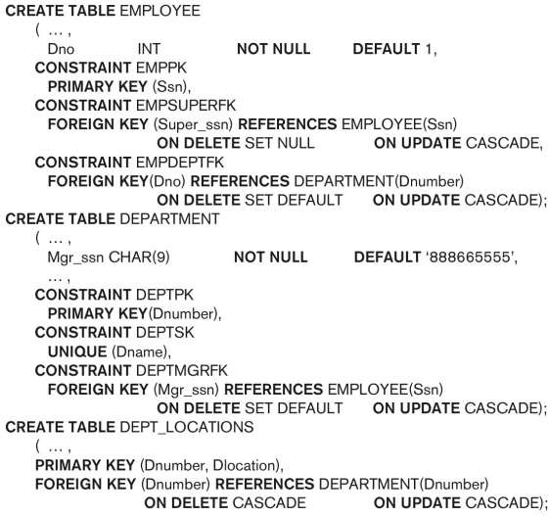
Default attribute values and referential integrity triggered action specification

Slide 28
Specifying Constraints on Tuples Using CHECK
Additional Constraints on individual tuples within a relation are also possible using CHECK
CHECK clauses at the end of a CREATE TABLE
statement
Apply to each tuple individually
CHECK (Dept_create_date <= Mgr_start_date);

Slide 29
Basic Retrieval Queries in SQL
SELECT statement
One basic statement for retrieving information from a database
SQL allows a table to have two or more tuples that are identical in all their attribute values
Unlike relational model (relational model is strictly set-theory based)
Multiset or bag behavior of tuples
Tuple-id may be used as a key

Slide 30
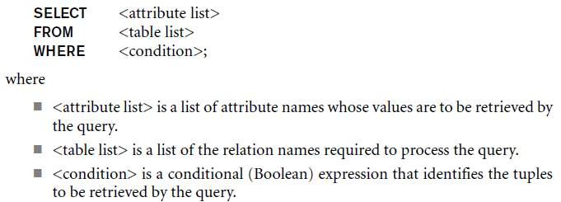
The SELECT-FROM-WHERE
Structure of Basic SQL Queries
Basic form of the SELECT statement:

Slide 31
The SELECT-FROM-WHERE Structure of Basic SQL Queries (cont’d.)
Logical comparison operators
■ =, <, <=, >, >=, and <>
Projection attributes
Attributes whose values are to be retrieved
Selection condition
Boolean condition that must be true for any retrieved tuple. Selection conditions include join conditions when multiple relations are involved.
Query 0. Retrieve the birth date and address of the employee(s) whose name is ‘John B. Smith’.

Slide 32
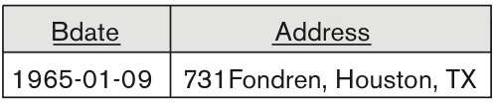
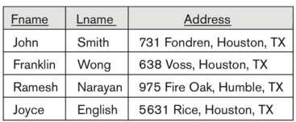
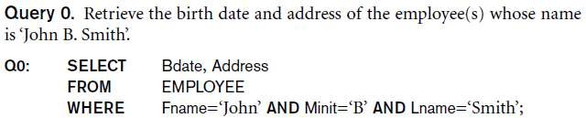
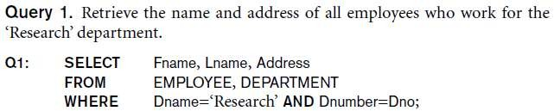
Basic Retrieval Queries

Slide 33

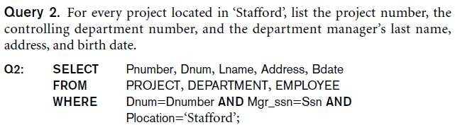
Basic Retrieval Queries (Contd.)

Slide 34

Ambiguous Attribute Names
Same name can be used for two (or more) attributes in different relations
As long as the attributes are in different relations
Must qualify the attribute name with the relation name to prevent ambiguity

Slide 35
Aliasing, and Renaming
Aliases or tuple variables
Declare alternative relation names E and S to refer to the EMPLOYEE relation twice in a query:
Query 8. For each employee, retrieve the employee’s first and last name and the first and last name of his or her immediate supervisor.
SELECT E.Fname, E.Lname, S.Fname, S.Lname
FROM EMPLOYEE AS E, EMPLOYEE AS S
■
WHERE E.Super_ssn=S.Ssn;
Recommended practice to abbreviate names and to prefix same or similar attribute from multiple tables.

Slide 36
Aliasing,Renaming and Tuple Variables (contd.)
The attribute names can also be renamed
EMPLOYEE AS E(Fn, Mi, Ln, Ssn, Bd,
Addr, Sex, Sal, Sssn, Dno)
Note that the relation EMPLOYEE now has a variable name E which corresponds to a tuple variable
The “AS” may be dropped in most SQL implementations

Slide 37
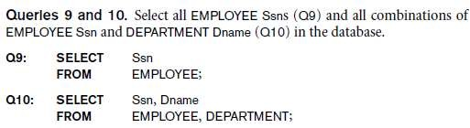
Unspecified WHERE Clause and Use of the Asterisk
Missing WHERE clause
Indicates no condition on tuple selection
Effect is a CROSS PRODUCT
Result is all possible tuple combinations
result

Slide 38
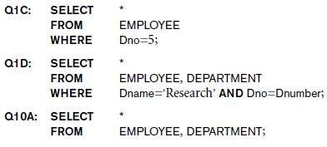
Unspecified WHERE Clause and Use of the Asterisk (cont’d.)
Specify an asterisk (*)
Retrieve all the attribute values of the selected tuples
The * can be prefixed by the relation name; e.g., EMPLOYEE *

Slide 39
Tables as Sets in SQL
SQL does not automatically eliminate duplicate tuples in query results
SQL does not automatically eliminate duplicate tuples in the results of queries, for the following reasons:
Duplicate elimination is an expensive operation. One way to implement it is to sort the tuples first and then eliminate duplicates.
The user may want to see duplicate tuples in the result of a query.
When an aggregate function is applied to tuples, in most cases we do not want to eliminate duplicates.

Slide 40
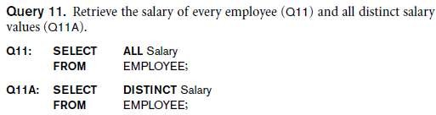
Tables as Sets in SQL
Use the keyword DISTINCT in the SELECT clause
Only distinct tuples should remain in the result

Slide 41
Tables as Sets in SQL (cont’d.)
SQL has directly incorporated some of the set operations from relational algebra directly
UNION, EXCEPT (difference), INTERSECT
The relations resulting from these set operations duplicate tuples are eliminated from the result.
Corresponding multiset operations: UNION ALL, EXCEPT ALL, INTERSECT ALL (duplicates are not eliminated)
Type compatibility is needed for these operations to be valid

Slide 42
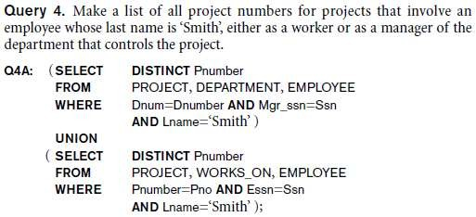
Tables as Sets in SQL (cont’d.)
The first SELECT query retrieves the projects that involve a ‘Smith’ as manager of the department that controls the project, and the second retrieves the projects that involve a ‘Smith’ as a worker on the project.
Notice that if several employees have the last name ‘Smith’, the project names involving any of them will be retrieved.
Applying the UNION operation to the two SELECT queries gives the desired result.

Slide 43
Substring Pattern Matching and Arithmetic Operators
LIKE comparison operator
Used for string pattern matching
% replaces an arbitrary number of zero or more characters
underscore (_) replaces a single character
Examples: WHERE Address LIKE ‘%Houston,TX%’;
WHERE Ssn LIKE ‘_ _ 1_ _ 8901’;
BETWEEN comparison operator
E.g., in Q14 :
WHERE(Salary BETWEEN 30000 AND 40000)
AND Dno = 5;

Slide 44
Arithmetic Operations
Standard arithmetic operators:
Addition (+), subtraction (–), multiplication (*), and division (/) may be included as a part of SELECT
Query 13. Show the resulting salaries if every employee working on
the ‘ProductX’ project is given a 10 percent raise.
SELECT E.Fname, E.Lname, 1.1 * E.Salary AS Increased_sal
FROM EMPLOYEE AS E, WORKS_ON AS W, PROJECT AS P
WHERE E.Ssn=W.Essn AND W.Pno=P.Pnumber AND
P.Pname=‘ProductX’;

Slide 45
Ordering of Query Results
Use ORDER BY clause
Keyword DESC to see result in a descending order of values
Keyword ASC to specify ascending order explicitly
Typically placed at the end of the query
ORDER BY D.Dname DESC, E.Lname ASC,
E.Fname ASC

Slide 46
Ordering of Query Results
Query 15. Retrieve a list of employees and the projects they are working on, ordered by department and, within each department, ordered alphabetically by last name, then first name.
SELECT D.Dname, E.Lname, E.Fname, P.Pname FROM DEPARTMENT D, EMPLOYEE E, WORKS_ON W,PROJECT P WHERE
D.Dnumber= E.Dno AND E.Ssn= W.Essn AND
W.Pno= P.Pnumber
ORDER BY D.Dname, E.Lname, E.Fname;

Slide 47
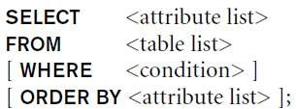
Basic SQL Retrieval Query Block
A simple retrieval query in SQL can consist of up to four clauses, but only the first two—SELECT and FROM—are mandatory.
The clauses are specified in the following order, with the clauses between square brackets [ ... ] being optional:

Slide 48
INSERT, DELETE, and UPDATE
Statements in SQL
Three commands used to modify the database:
INSERT, DELETE, and UPDATE
INSERT typically inserts a tuple (row) in a relation (table)
UPDATE may update a number of tuples (rows) in a relation (table) that satisfy the condition
DELETE may also update a number of tuples (rows) in a relation (table) that satisfy the condition

Slide 49
INSERT
In its simplest form, it is used to add one or more tuples to a relation
Attribute values should be listed in the same order as the attributes were specified in the CREATE TABLE command
Constraints on data types are observed automatically
Any integrity constraints as a part of the DDL specification are enforced

Slide 50


The INSERT Command
Specify the relation name and a list of values for the tuple. All values including nulls are supplied.
The variation below inserts multiple tuples where a new table is loaded values from the result of a query.

Slide 51
DELETE
Removes tuples from a relation
Includes a WHERE-clause to select the tuples to be deleted
Referential integrity should be enforced
Tuples are deleted from only one table at a time (unless CASCADE is specified on a referential integrity constraint)
A missing WHERE-clause specifies that all tuples in the relation are to be deleted; the table then becomes an empty table
The number of tuples deleted depends on the number of tuples in the relation that satisfy the WHERE-clause
We must use the DROP TABLE command to remove the table definition

Slide 52
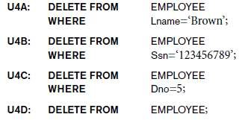
The DELETE Command
Removes tuples from a relation
Includes a WHERE clause to select the tuples to be deleted. The number of tuples deleted will vary.

Slide 53
UPDATE
Used to modify attribute values of one or more selected tuples
A WHERE-clause selects the tuples to be modified
An additional SET-clause specifies the attributes to be modified and their new values
Each command modifies tuples in the same relation
Referential integrity specified as part of DDL specification is enforced

Slide 54
UPDATE (contd.)
Example: Change the location and controlling department number of project number 10 to 'Bellaire' and 5, respectively
U5:
UPDATE SET
PROJECT
PLOCATION = 'Bellaire', DNUM = 5
PNUMBER=10
WHERE

Slide 55
UPDATE (contd.)
Example: Give all employees in the 'Research' department a 10% raise in salary.
U6:UPDATE SET WHERE
EMPLOYEE
SALARY = SALARY *1.1
DNO IN (SELECT DNUMBER
FROM DEPARTMENT
WHERE DNAME='Research')
In this request, the modified SALARY value depends on
the original SALARY value in each tuple
The reference to the SALARY attribute on the right of = refers to the old SALARY value before modification
The reference to the SALARY attribute on the left of = refers to the new SALARY value after modification

Slide 56
Exercise Queries
Show the result of each query if it is applied to the COMPANY database.
Retrieve the names of all employees in department 5 who work more than 10 hours per week on the ProductX project.
List the names of all employees who have a dependent with the same first name as themselves.
Find the names of all employees who are directly supervised by ‘Franklin Wong’.

Slide 57
More Complex SQL Retrieval Queries
Comparisons Involving NULL and Three-Valued Logic
SQL has various rules for dealing with NULL values.
NULL is used to represent a missing value, but that it usually has one of three different interpretations—value unknown (exists but is not known), value not available (exists but is purposely withheld), or value not applicable (the attribute is undefined for this tuple)

Slide 58
Query 18. Retrieve the names of all employees who do not have supervisors.
Q18: SELECT Fname, Lname FROM EMPLOYEE WHERE Super_ssn IS NULL;
We can use IS and IS NOT in the WHERE clause

Slide 59
Nested Queries, Tuples, and Set/Multiset Comparisons
Some queries require that existing values in the database be fetched and then used in a comparison condition.
Such queries can be conveniently formulated by using nested queries, which are complete select-from-where blocks within the WHERE clause of another query.
That other query is called the outer query.
SQL allows the use of tuples of values in comparisons by placing them within parentheses.

Slide 60
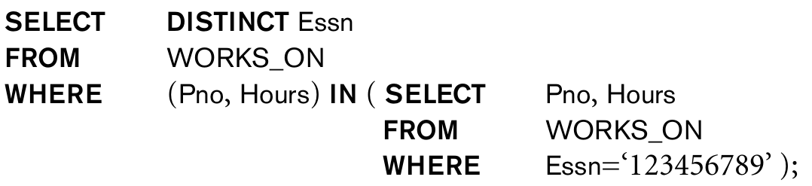
This query will select the Essns of all employees who work the same (project, hours) combination on some project that employee ‘John Smith’ (whose Ssn = ‘123456789’) works on. In this example, the IN operator compares the subtuple of values in parentheses (Pno, Hours) within each tuple in WORKS_ON with the set of type-compatible tuples produced by the nested query.

Slide 61
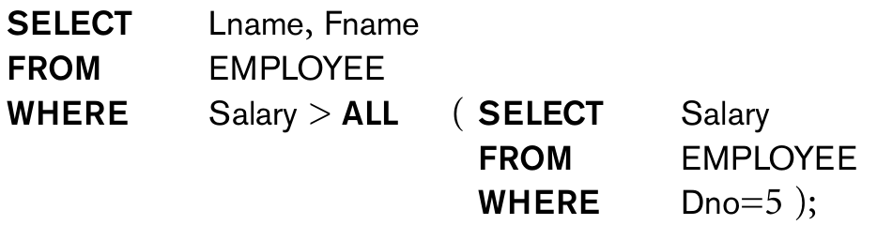
Retrieve the names of employees whose salary is greater than the salary of all the employees in department 5

Slide 62
Correlated Nested Queries
Whenever a condition in the WHERE clause of a nested query references some attribute of a relation declared in the outer query, the two queries are said to be correlated.
We can understand a correlated query better by considering that the nested query is evaluated once for each tuple (or combination of tuples) in the outer query.
In general, a query written with nested select-from-where blocks and using the = or IN comparison operators can always be expressed as a single block query

Slide 63
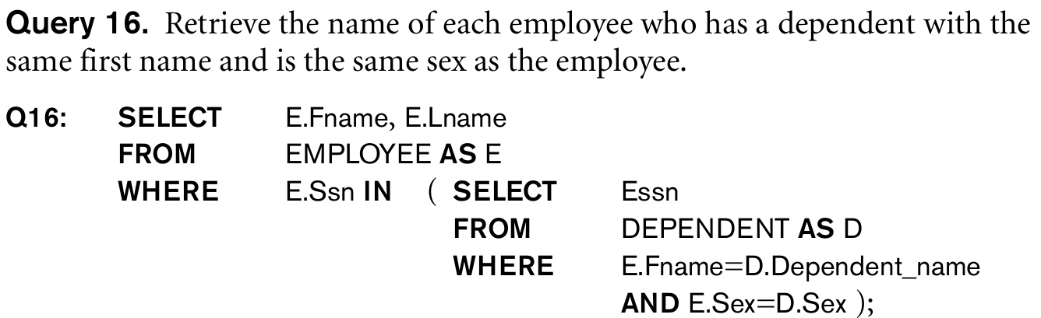
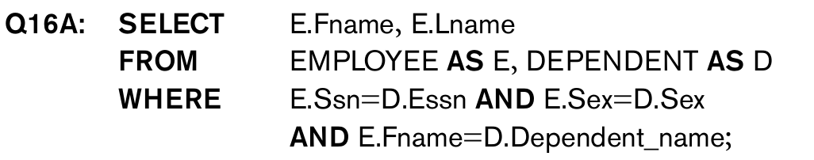
Can be rewritten as corelated query as follows:

Slide 64
The EXISTS and UNIQUE Functions in SQL
EXISTS is used to check whether the result of a correlated nested query is empty (contains no tuples) or not
The result of EXISTS is a Boolean value TRUE if the nested query result contains at least one tuple, or FALSE if the nested query result contains no tuples.

Slide 65
THE EXISTS FUNCTION (contd.)
Query : Retrieve the name of each employee who has a dependent with the same first name as the employee.
Q: SELECT FNAME, LNAME FROM EMPLOYEE WHERE EXISTS (SELECT * FROM DEPENDENT WHERE SSN=ESSN AND FNAME=DEPENDENT_NAME)

Slide 66
THE EXISTS FUNCTION (contd.)
Query 6: Retrieve the names of employees who have no dependents.
Q6: SELECT FNAME, LNAME FROM EMPLOYEE WHERE NOT EXISTS (SELECT * FROM DEPENDENT WHERE SSN=ESSN)
In Q6, the correlated nested query retrieves all DEPENDENT tuples related to an EMPLOYEE tuple. If none exist, the EMPLOYEE tuple is selected
EXISTS is necessary for the expressive power of SQL

Slide 67
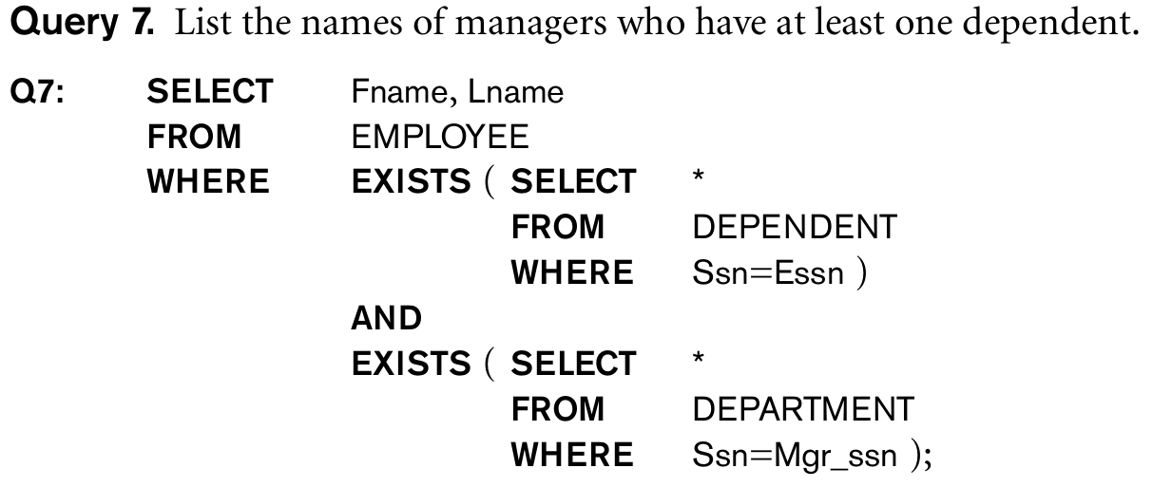

Slide 68
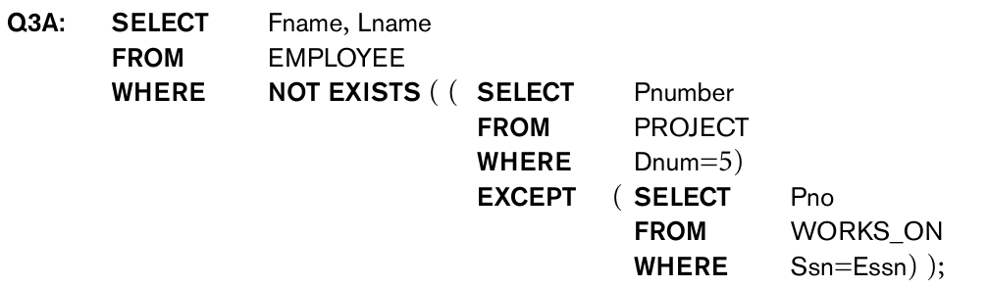
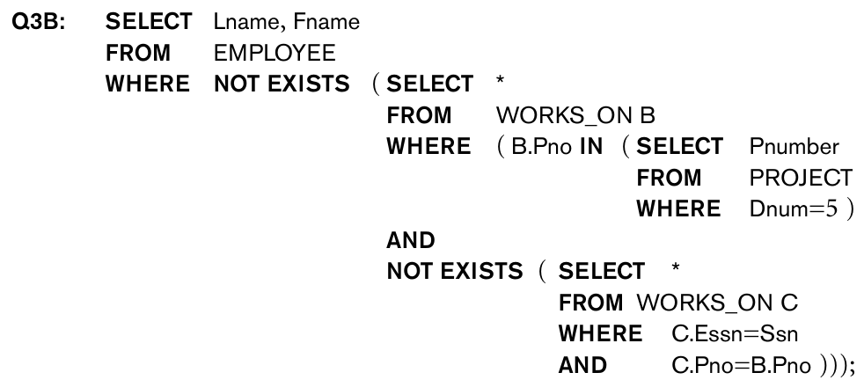
Q3: Retrieve the name of each employee who works on all the projects con trolled by department number 5 can be written using EXISTS and NOT EXISTS in SQL systems. 2ways to solve this as follows:

Slide 69
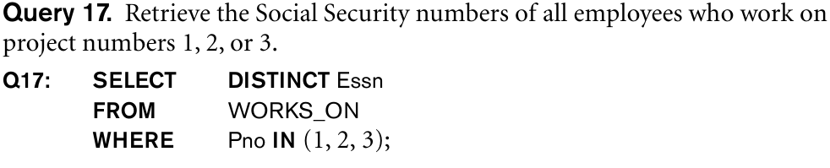
Explicit Sets and Renaming of Attributes in SQL
It is also possible to use an explicit set of values in the WHERE clause, rather than a nested query. Such a set is enclosed in parentheses in SQL.

Slide 70
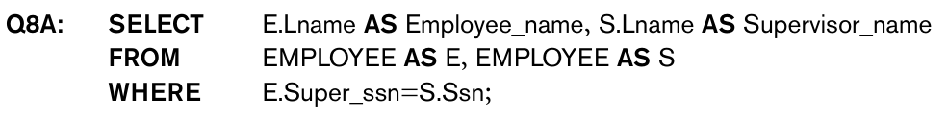
In SQL, it is possible to rename any attribute that appears in the result of a query by adding the qualifier AS followed by the desired new name.
Hence, the AS construct can be used to alias both attribute and relation names, and it can be used in both the SELECT and FROM clauses.

Slide 71
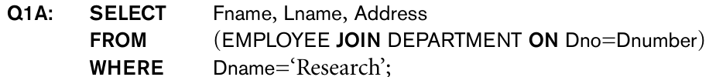
Joined Tables in SQL and Outer Joins
The concept of a joined table (or joined relation) was incorporated into SQL to permit users to specify a table resulting from a join operation in the FROM clause of a query.
For example, consider query Q1, which retrieves the name and address of every employee who works for the ‘Research’ department.
It may be easier to specify the join of the EMPLOYEE and DEPARTMENT relations first, and then to select the desired tuples and attributes. This can be written in SQL as in Q1A:
This query gives a single joined table.

Slide 72
The attributes of such a table are all the attributes of the first table, EMPLOYEE, followed by all the attributes of the second table, DEPARTMENT
In a NATURAL JOIN on two relations R and S, no join condition is specified; an implicit EQUIJOIN condition for each pair of attributes with the same name from R and S is created.
Each such pair of attributes is included only once in the resulting relation
If the names of the join attributes are not the same in the base relations, it is possible to rename the attributes so that they match, and then to apply NATURAL JOIN by using AS construct.

Slide 73
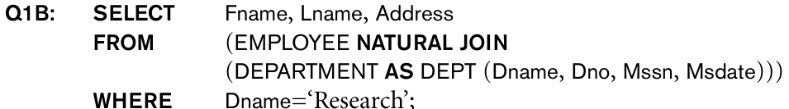
The implied join condition for this NATURAL JOIN is EMPLOYEE.Dno=DEPT.Dno, because this is the only pair of attributes with the same name after renaming:

Slide 74
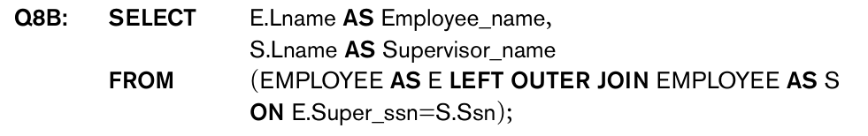
The default type of join in a joined table is called an inner join, where a tuple is included in the result only if a matching tuple exists in the other relation.
If the user requires that all tuples be included, an OUTER JOIN must be used explicitly .

Slide 75
In SQL, the options available for specifying joined tables include INNER JOIN (only pairs of tuples that match the join condition are retrieved, same as JOIN),
LEFT OUTER JOIN (every tuple in the left table must appear in the result; if it does not have a matching tuple, it is padded with NULL values for the attributes of the right table),
RIGHT OUTER JOIN (every tuple in the right table must appear in the result; if it does not have a matching tuple, it is padded with NULL values for the attributes of the left table), and
FULL OUTER JOIN. In the latter three options, the keyword OUTER may be omitted.
If the join attributes have the same name, one can also specify the natural join variation of outer joins by using the keyword NATURAL before the operation (for example, NATURAL LEFT OUTER JOIN).
The keyword CROSS JOIN is used to specify the CARTESIAN PRODUCT operation, although this should be used only with the utmost care because it generates all possible tuple combinations.

Slide 76
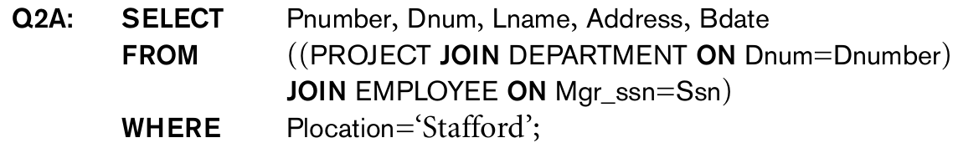
It is also possible to nest join specifications; that is, one of the tables in a join may itself be a joined table. This allows the specification of the join of three or more tables as a single joined table, which is called a multiway join.

Slide 77
AGGREGATE FUNCTIONS
Include COUNT, SUM, MAX, MIN, and AVG
Query 15: Find the maximum salary, the minimum salary, and the average salary among all employees.
Q15: SELECT MAX(SALARY), MIN(SALARY), AVG(SALARY) FROM EMPLOYEE
Some SQL implementations may not allow more than one function in the SELECT-clause

Slide 78
AGGREGATE FUNCTIONS (contd.)
Query 16: Find the maximum salary, the minimum salary, and the average salary among employees who work for the 'Research' department.
Q16: SELECT MAX(SALARY), MIN(SALARY), AVG(SALARY) FROM EMPLOYEE, DEPARTMENT WHERE DNO=DNUMBER AND DNAME='Research'

Slide 79
AGGREGATE FUNCTIONS (contd.)
Queries 17 and 18: Retrieve the total number of employees in the company (Q17), and the number of employees in the 'Research' department (Q18).
Q17: SELECT COUNT (*) FROM EMPLOYEE
Q18: SELECT COUNT (*) FROM EMPLOYEE, DEPARTMENT WHERE DNO=DNUMBER AND DNAME='Research’

Slide 80

Count the number of distinct salary values in the database.
In general, NULL values are discarded when aggregate functions are applied to a particular column (attribute).

Slide 81
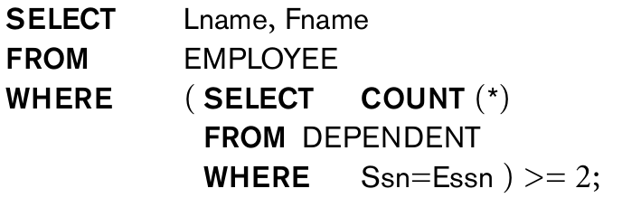
We can specify a correlated nested query with an aggregate function, and then use the nested query in the WHERE clause of an outer query.
For example, to retrieve the names of all employees who have two or more dependents, we can write the following:

Slide 82
GROUPING
In many cases, we want to apply the aggregate functions to subgroups of tuples in a relation
Each subgroup of tuples consists of the set of tuples that have the same value for the grouping attribute(s)
The function is applied to each subgroup independently
SQL has a GROUP BY-clause for specifying the grouping attributes, which must also appear in the SELECT-clause

Slide 83
GROUPING (contd.)
Query 20: For each department, retrieve the department number, the number of employees in the department, and their average salary.
Q20: SELECT DNO, COUNT (*), AVG (SALARY) FROM EMPLOYEE GROUP BY DNO
In Q20, the EMPLOYEE tuples are divided into groups-
Each group having the same value for the grouping attribute DNO
The COUNT and AVG functions are applied to each such group of tuples separately
The SELECT-clause includes only the grouping attribute and the functions to be applied on each group of tuples
A join condition can be used in conjunction with grouping

Slide 84
GROUPING (contd.)
Query 21: For each project, retrieve the project number, project name, and the number of employees who work on that project.
Q21: SELECT PNUMBER, PNAME, COUNT (*) FROM PROJECT, WORKS_ON WHERE PNUMBER=PNO GROUP BY PNUMBER, PNAME
In this case, the grouping and functions are applied after the joining of the two relations

Slide 85
THE HAVING-CLAUSE
Sometimes we want to retrieve the values of these functions for only those groups that satisfy certain conditions
The HAVING-clause is used for specifying a selection condition on groups (rather than on individual tuples)

Slide 86
THE HAVING-CLAUSE (contd.)
Query 22: For each project on which more than two employees work, retrieve the project number, project name, and the number of employees who work on that project.
Q22: SELECT PNUMBER, PNAME, COUNT(*) FROM PROJECT, WORKS_ON WHERE PNUMBER=PNO GROUP BY PNUMBER, PNAME HAVING COUNT (*) > 2

Slide 87
Summary of SQL Queries
A query in SQL can consist of up to six clauses, but only the first two, SELECT and FROM, are mandatory. The clauses are specified in the following order: SELECT <attribute list> FROM <table list> [WHERE <condition>] [GROUP BY <grouping attribute(s)>] [HAVING <group condition>] [ORDER BY <attribute list>]

Slide 88
Summary of SQL Queries (contd.)
The SELECT-clause lists the attributes or functions to be retrieved
The FROM-clause specifies all relations (or aliases) needed in the query but not those needed in nested queries
The WHERE-clause specifies the conditions for selection and join of tuples from the relations specified in the FROM-clause
GROUP BY specifies grouping attributes
HAVING specifies a condition for selection of groups
ORDER BY specifies an order for displaying the result of a query
A query is evaluated by first applying the WHERE-clause, then GROUP BY and HAVING, and finally the SELECT-clause

